Slide 1



T:BUC Engagement Forum - 15 June, 2017
Dr. Mark Browne
Director of Strategic Policy, Equality & Good Relations
The Executive Office

Slide 2
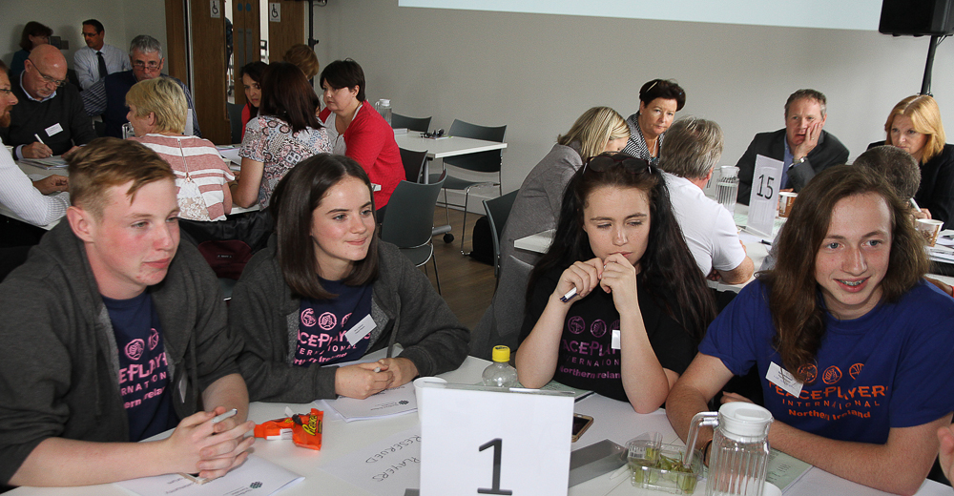
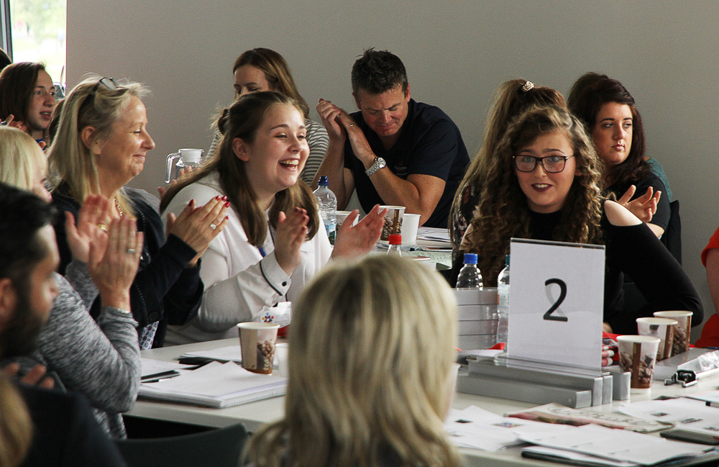
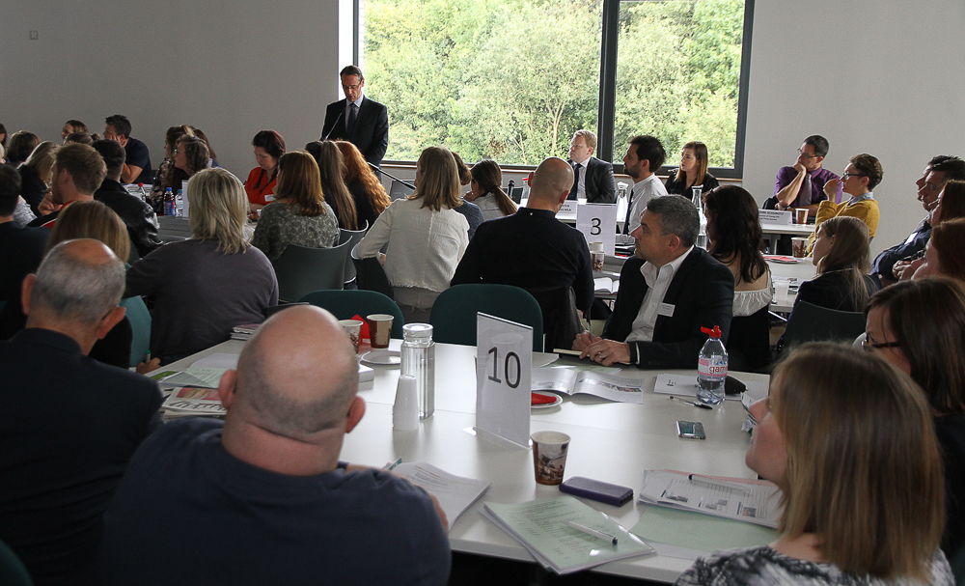
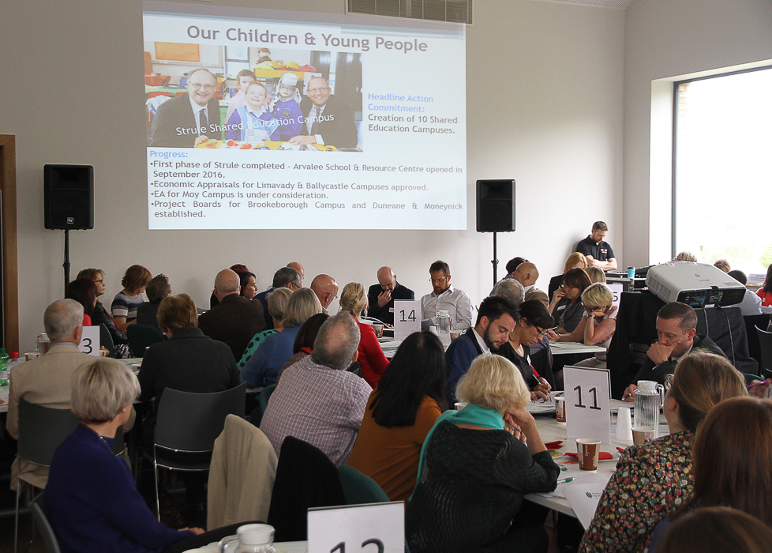
T:BUC Engagement Forum

Slide 3
TEO Funding Programmes
Central Good Relations Fund
North Belfast Good Relations Programme
Planned Interventions Fund
Minority Ethnic Development Fund
T:BUC Camps
Community Relations Council
District Council Good Relations Programme
c.£12.5m in 2016/2017

Slide 4
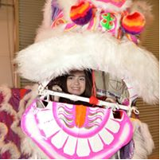

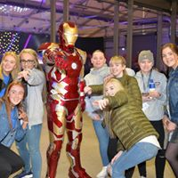
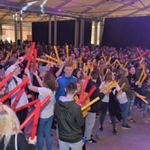
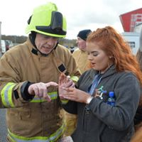
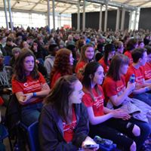



Our Children & Young People
The connection between all of us made it feel like one big club and there was no divide between religions. It’s a very unreal and special place and I was glad to be part of it.
Headline Action Commitment:
Pilot 100 Shared Summer Schools by 2015.
Progress:
101 Camps in 2015/16.
104 Camps in 2016/17.
126 Camps in 2017/18.
/tbuccamps
/TBUCCamps

Slide 5
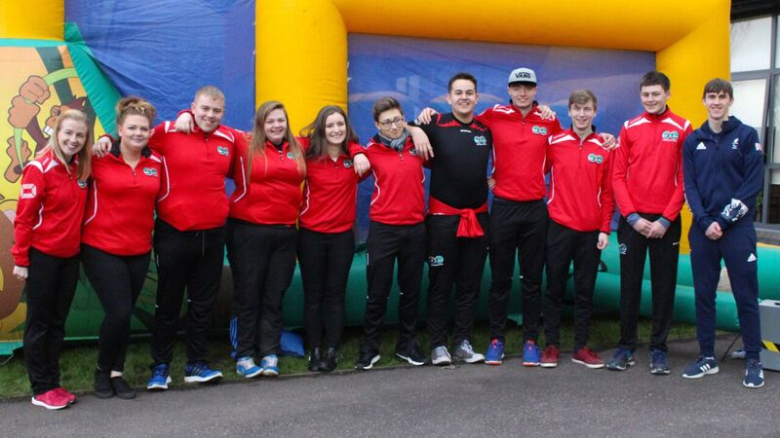
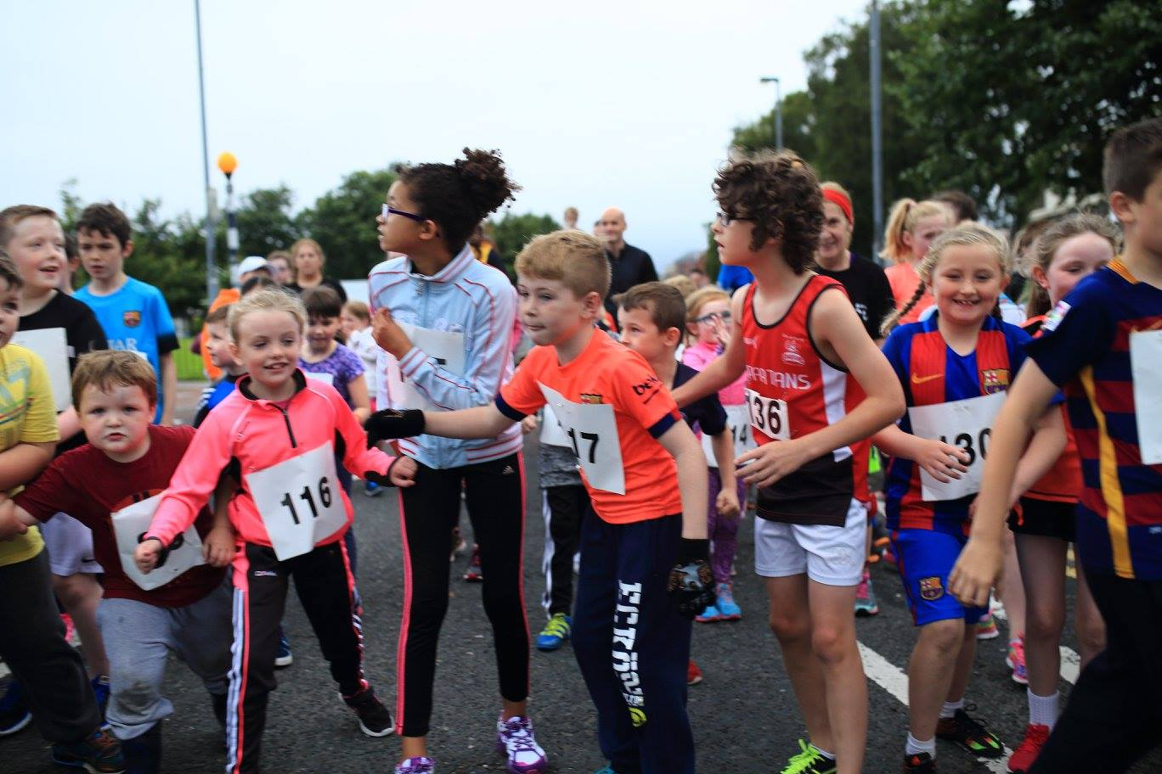
Our Cultural Expression
Headline Action Commitments:
Develop a significant programme of Cross-Community Sporting Events.
Getting 10,000 young people, not in education, employment or training, a place on the new United Youth volunteering programme.
Progress:
Sports programme piloted and rolled out in two Urban Village areas (Colin & Eastside) and also in Erne East to 150 young people.
United Youth Pilot completed.
Youth Initiative being taken forward under Peace IV.

Slide 6
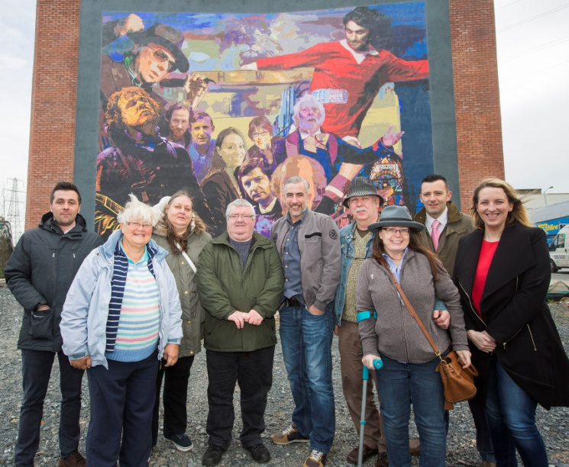
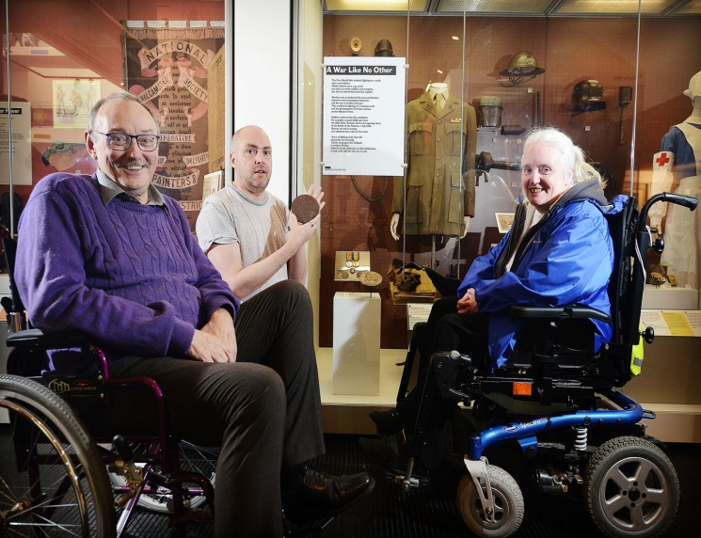

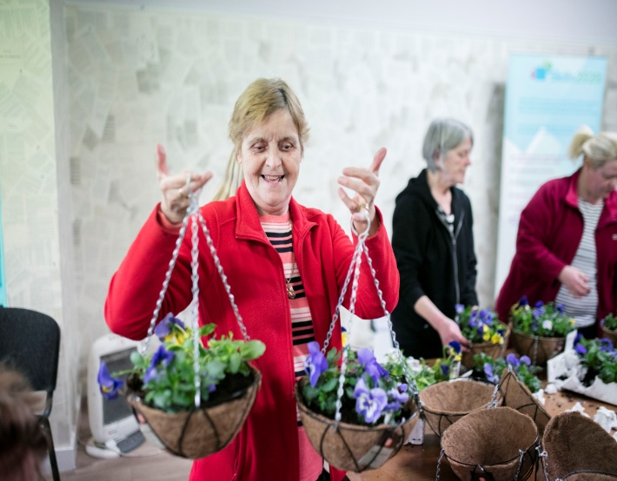

Our Shared Community
Headline Action Commitment:
Establish 5 Urban Villages.
Progress:
5 Urban Villages in place
5 Strategic frameworks launched.
£4m capital programme planned for 2017/18.
£1.6m revenue programme per annum.

Slide 7
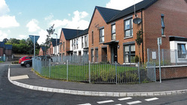
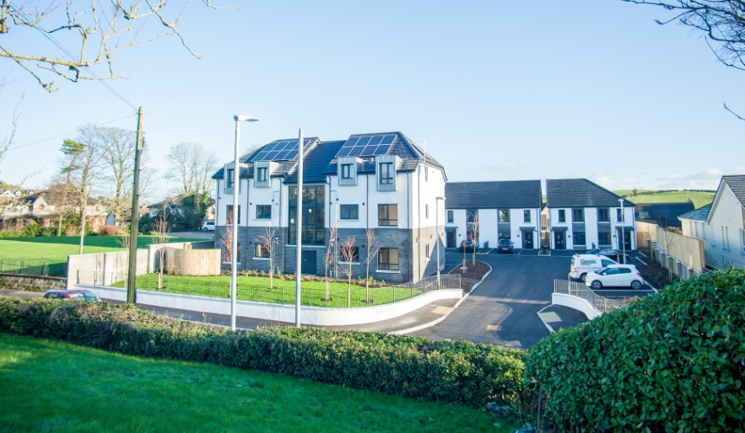
Our Shared Community
Headline Action Commitment:
10 shared neighbourhoods.
Progress:
5 schemes have been completed.
5 are being progressed.
Burnvale Crescent, Cookstown
Mural at the entrance to Ballnafoy Close
Crossgar Road, Saintfield

Slide 8
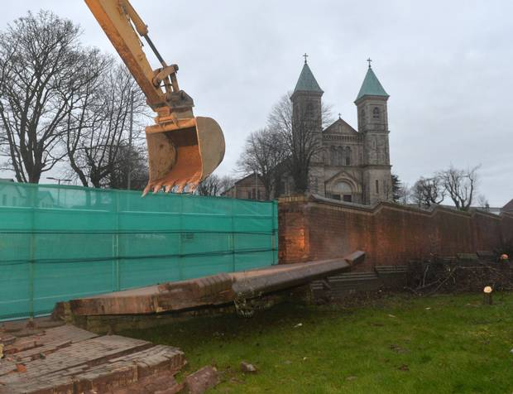
Our Safe Community
Headline Action Commitment:
Remove all interface barriers by 2023
Progress:
54 interface barriers in 2013 now reduced to 50.
Sections of other structures removed.
Action plans developed for 24 structures.
/DoJInterfaces
/DoJ_Interfaces

Slide 9
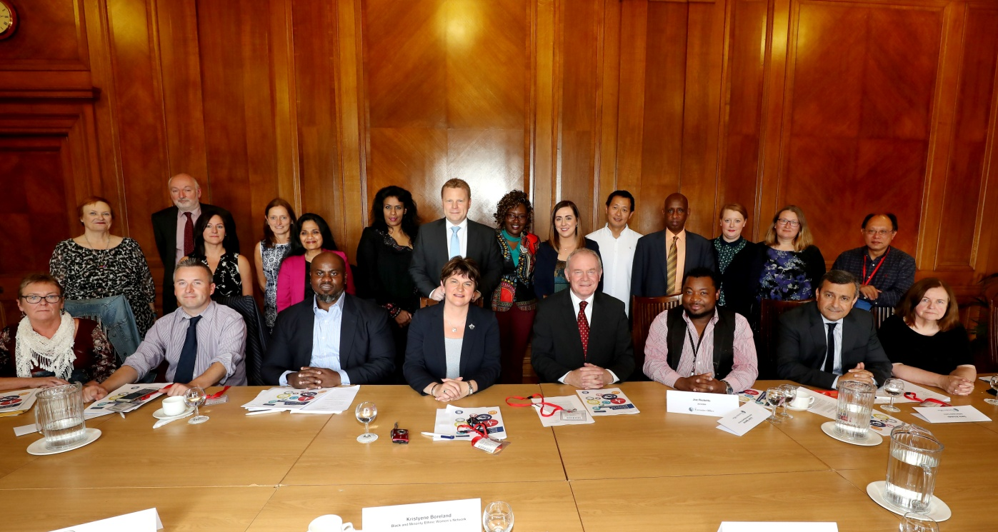
Racial Equality
Commitment:
Develop a new Racial Equality Strategy.
Progress:
Racial Equality Strategy agreed by Executive, December 2015
Racial Equality Sub-Group established in September 2016.
Racial Equality Champions appointed in departments.
Minority Ethnic Development Fund (MEDF) LOOs to issue by next week.
511 Syrian refugees welcomed under the Syrian Vulnerable Persons Relocation Scheme and 9th group (of 70) due later this month.

Slide 10
Draft Programme for Government
Outcomes focussed
13 outcomes
Progress measured through indicators
Key focus is on impact ie making a difference
“Is anyone better off?”
Key Outcome in Good Relations sphere:
“We are a shared, welcoming and confident society that respects diversity”

Slide 11
“We are a shared, welcoming and confident society that respects diversity”
Key area for action | Indicator
Respect | A Respect Index (under development)
Shared Space | % who think all leisure centres, parks, libraries and shopping centres in their areas are ‘shared & open’ to both Catholics & Protestants. (needs widened to all s75 groups)
Reconciliation | % of the population who believe their cultural identity is respected by society. (needs to include all s75 groups)
Other Indicators: Average life satisfaction score of people with disabilities. Confidence (as measured by self-efficacy).

Slide 12
Agenda
10.00 Welcome & T:BUC Update
              Dr. Mark Browne, The Executive Office and T:BUC Engagement Forum Chair
              10.20 Shared Space
              Like/Share film by Partisan Productions
10.35 Reconciliation: A road forward?
Professor Brandon Hamber, INCORE International Conflict Research Institute
10.55 Comfort Break
11.15 Workshop
Shared Space
Reconciliation
12.15 Discussion and Feedback
13.10 Closing remarks
            Dr. Mark Browne
13.15 Lunch

Slide 13

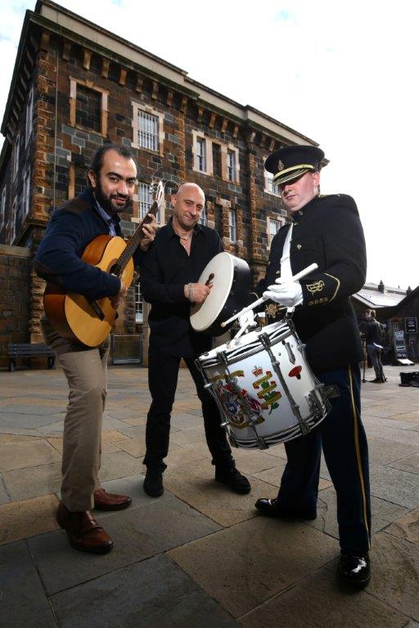
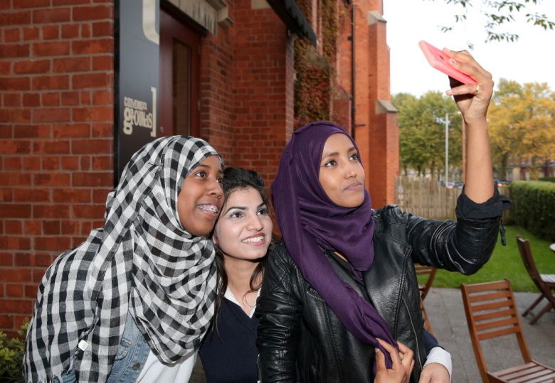

Dates for your Diary
Next T:BUC Engagement Forum – 19 September
Community Relations & Cultural Awareness Week
w/c 18 September 2017 in conjunction with International Peace Day.
The theme is ‘Safe Space, Shared Place’.

