Slide 1


Welcome
CORE FUNDING SCHEME 2027 – 2028

Slide 2

Introduction to the Programme
NICRC is an ALB of The Executive Office (TEO) and administers this Core Funding Programme on its behalf.
It complements funding provided by TEO and contributes to the delivery of Together: Building a United Community (T:BUC) priorities.
Contributes towards salary and running costs for organisations with strategic importance in the delivery of community relations work in Northern Ireland.
Focus of the scheme is to address sectarianism – need for very clear details within the application.
Annual Programme budget of c£1.2 million - Approx. £600k to allocate in this round

Slide 3

Strategic Priorities for 2027-28 Core Funding
The NICRC has produced Welcome Statements relating to the geographic reach and thematic impact of the types of supported work it would like to see for the 2027-28 period.
Geographic Impact
The NICRC would welcome applications which will deliver community relations programmes in the following areas:
Ards and North Down
Armagh, Banbridge & Craigavon
Belfast (East)
Belfast (South)
Lisburn and Castlereagh
Mid & East Antrim
Mid-Ulster
Newry, Mourne and Down
The NICRC also welcomes applications which will deliver community relations programmes in rural and/or border communities.

Slide 4


Thematic Impact
The NICRC would welcome applications that support the following areas of activity:
Developing understanding, tolerance, respect, networks of connection and community relations within and across communities.
Involving the hardest to reach participants including those most impacted by sectarian and racist tensions and those that have not engaged or have had limited engagement in community relations work.
Building confidence to engage with other identities.
Integrating community relations into everyday life and other activities of social benefit.
Networked delivery across area-based work.

Slide 5
Checking stage (prior to assessment)
Is the organisation legally able to operate in Northern Ireland?
Is the organisation financially viable?
Is there clear demonstration that robust financial and reporting systems are in place?
Is there an adequate Community Relations/ Good Relations or Equality Policy in operation?
Has the applicant completed the form fully and provided all correct documentation as required in the Additional Information and Declaration section of the application?
Does the work described in the applicants work plan meet the specific remit of this funding Programme
Are the proposed beneficiaries all Northern Ireland based?

Slide 6

What We Fund
Salary Costs
For those posts that are directly described in the work plan and should primarily deliver community relations related activity.
Finance/admin costs will be supported for a maximum of 2 full days salary per week and up to a maximum of £7,500 (total requested from CRC).
This Programme will only provide up to a maximum of 90% of salary costs.
Associated Organisational Running Costs
Mileage associated with the salaried post requested (up to a maximum of 0.45p per mile)
Rent
Heat and Light
Telephone/Internet (landline costs only)
Insurance
Please note the total running costs cannot exceed 25% of the total grant requested.

Slide 7

What We Do Not Fund
Work which falls within the remit and responsibility of other funders including but not exclusive to:
    work with minority ethnic or minority faith communities (TEO Minority Ethnic Development Fund); or
    work with victims and survivors (Victims and Survivors Service)
Proposals submitted by individuals
Work outside of Northern Ireland
The scheme will not support the running of campaigns to support political activities, or to lobby for or against particular pieces of legislation
Capital costs
Audit costs
Purchase of equipment
100% of costs (availability of match funding must be demonstrated)
Project delivery costs

Slide 8

Assessment process
Three elements that will be considered:
Assessment of the application and materials presented
Financial analysis and scrutiny
Any significant findings from review (for groups currently in receipt of core funding)
Assessment is scored using the following guidelines:
Methodology/ Outcomes 60%
Value for Money 26%
Governance/Financial Arrangements 14%
and Organisational Experience and
Management

Slide 9
Assessment process
Methodology / Outcomes
Alignment of outcomes with strategic priorities / welcome statements and geographical and beneficiary reach
Clear evidence of need
Fit with the programme remit and themes
Detailed methodology and approach for carrying out the work plan with a quarterly breakdown of the work being carried out, including details on beneficiaries and delivery partners
Clear and measurable strategic outcomes with indicators/progress measures
Potential risk factors and proposed actions to mitigate against these risks
Understanding of the policy and contextual issues within the CR sectornance

Slide 10
Assessment process
Value for Money
Adequate match funding
Costs that directly contribute to delivery of the described work programme
Overall cost of the work plan proportionate to the quality of work and quality of outcomes that will be achieved
Budget clearly presented and the figures are realistic and proportionate
Governance / Financial Arrangements and Organisational Experience and Management
Evidence of skills / proven track record in delivery of practical CR interventions
Evidence of good governance arrangements: Board/ organisational structure/ effective reporting arrangements / organisational management

Slide 11

Core Funding Scheme 2027-2028
The Application Form
WWW.NICRC.ORG.UK

Slide 12

Common Mistakes
Eligibility failures – not submitting the correct documentation
Not reading the FAQs together with the CORE Funding Guidelines
Duplication of answers across several questions
Not actually answering the questions
Not providing supporting evidence for the demonstration of need
Not providing a detailed timeline for Year 1
Not being clear in the application how each post applied for fits into the proposed workplan(s)
Not clearly detailing where the match funding is coming from, i.e. if applying for 90% of a salary, you need to detail how the remaining 10% of the salary with be provided for.
Not providing details of other funding secured or applied for of the overall organisation
Not detailing delivery partners and their roles in the workplan(s)
Not detailing how proposed outcomes will be measured

Slide 13

Key Points to Consider
Read the guidance notes thoroughly before completing the application.
When considering the CR value of your proposal use the “Key Principles” within the Guidance which outlines the information you should include.
Do not assume prior knowledge of your work. We can only score on the information provided in the application.
Make sure that you have uploaded all your documentation before submitting your bid. The system will not recognise whether it is the correct information uploaded.
Plain English is fine, there aren’t any “buzz words” that we are looking for.
There is a difference between “Management Accounts” and Annual Accounts we require both.

Slide 14

Submission
Thursday 12th November @ 4.00pm
We will not accept documents forwarded to us separately or documents supplied to us after this deadline

Slide 15
Assessment and Decision Timeline
Assessment of Applications:
November 2026 – March 2027
Decision Panel:
Week commencing Monday 22nd March 2027

Slide 16

Contact Details:
Brian McDonald – Director of Funding and Development
bmcdonald@nicrc.org.uk
Karina Pieterson – CORE Funding and Development Officer
kpieterson@nicrc.org.uk
Damien McNally – CORE Fund Evaluation Officer
dmcnally@nicrc.org.uk
Ellana Tomasso - Information Administration Officer
etomasso@nicrc.org.uk

Slide 17


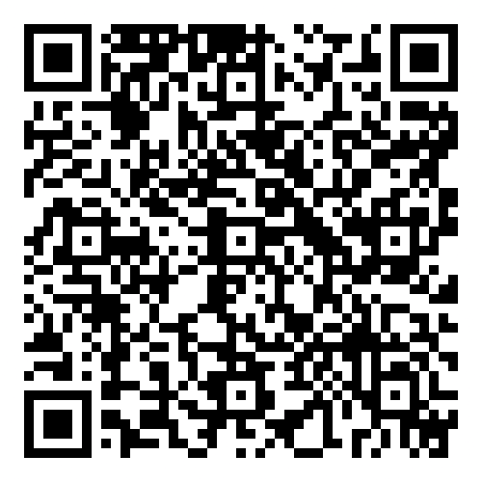
Thank you for your time
CORE Fund ‘Making a Difference’ Impact Report 2025-2026

